Slide 1
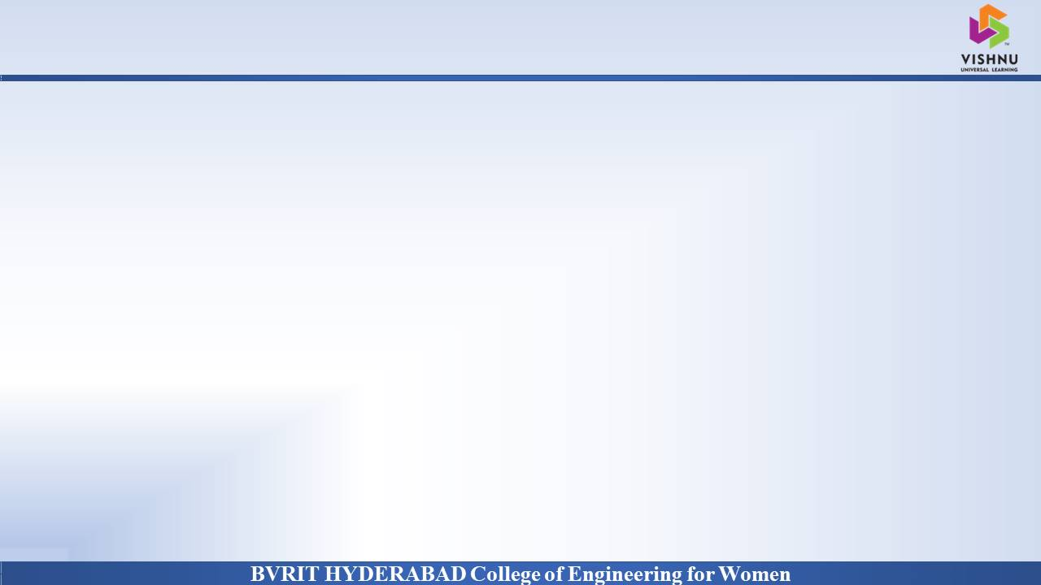
Department of Computer Science and Engineering
OBJECT DETECTION AND LOCALIZATION
Date: 27 May 2021
G. VAISHNAVI : 17WH1A0564
NAKHVEEN AHMED : 17WH1A0580
B. ANJANI : 17WH1A0583
Internal Guide: Ms. SUPARNA DAS
Designation : Assistant Professor

Slide 2

Abstract
Why Should I Study this course?
We are using YOLO, a new approach to object detection. Prior work on object detection repurposes classifiers to perform detection.
Instead, we frame object detection as a regression problem to spatially separated bounding boxes and associated class probabilities.
A single neural network predicts bounding boxes and class probabilities directly from full images in one evaluation.
Our base YOLO model processes images in real-time at 45 frames per second. A smaller version of the network, Fast YOLO, processes an astounding 155 frames per second while still achieving double the map of other real-time detectors.
YOLO makes more localization errors but is less likely to predict false positives on background.
Finally, YOLO learns very general representations of objects. It outperforms other detection methods, including DPM and R-CNN, when generalizing from natural images to other domains like artwork.
Examples
BVRIT HYDERABAD College of Engineering for Women

Slide 3
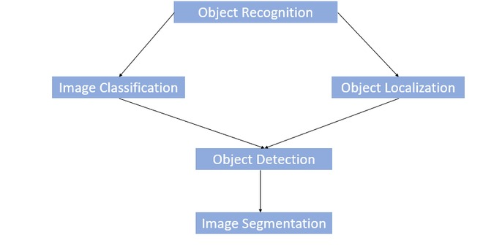
Block Diagram
Why Should I Study this course?
Examples
BVRIT HYDERABAD College of Engineering for Women

Slide 4
SYSTEM SPECIFICATIONS
Why Should I Study this course?
ENVIRONMENT
Examples
SPECIFICATIONS
Processor- Intel Core i3/i5
Memory(RAM)-8GB
Storage- 1 TB
Python/ Matlab
OS- Window 10
Google Collab
Hardware
Software
BVRIT HYDERABAD College of Engineering for Women

Slide 5
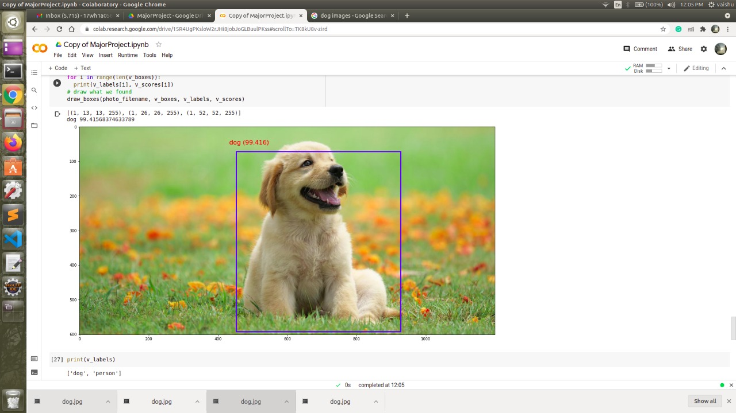
OUTPUT
BVRIT HYDERABAD College of Engineering for Women

Slide 6
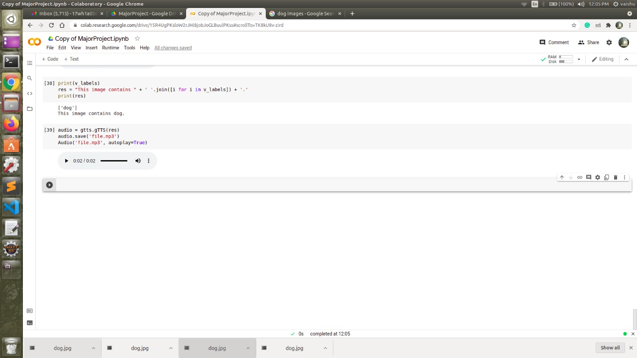
OUTPUT

Slide 7
Thankyou

